Slide 1
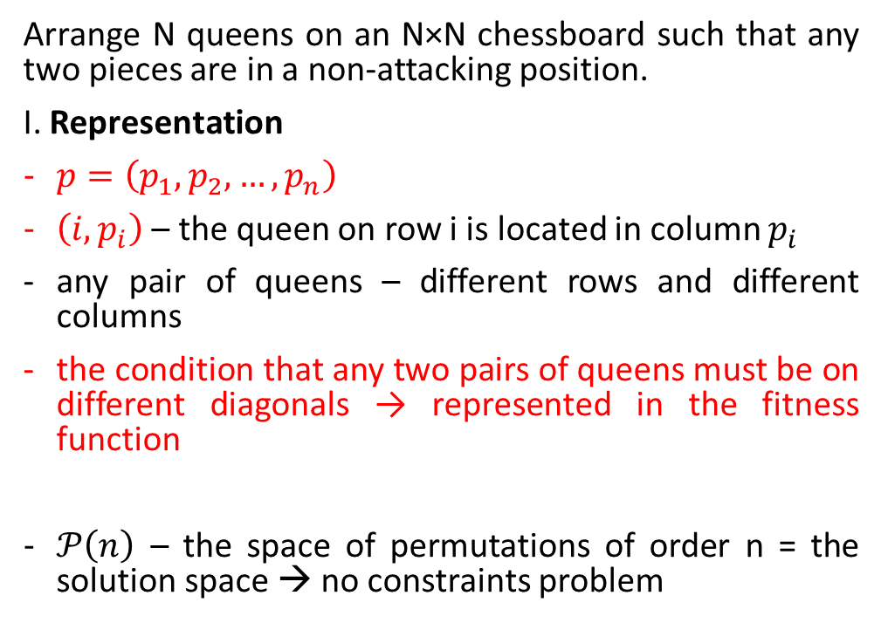

N-Queens problem
Arrange N queens on an N×N chessboard such that any two pieces are in a non-attacking position.
I. Representation
$p=\left(p_{1},p_{2},…,p_{n}\right)$
$\left(i,p_{i}\right)$ – the queen on row i is located in column $p_{i}$
any pair of queens – different rows and different columns
the condition that any two pairs of queens must be on different diagonals → represented in the fitness function
$𝒫\left(n\right)$ – the space of permutations of order n = the solution space → no constraints problem
$$P=\left(7, 1, 4, 6, 8, 3, 5, 2\right)$$

Slide 2
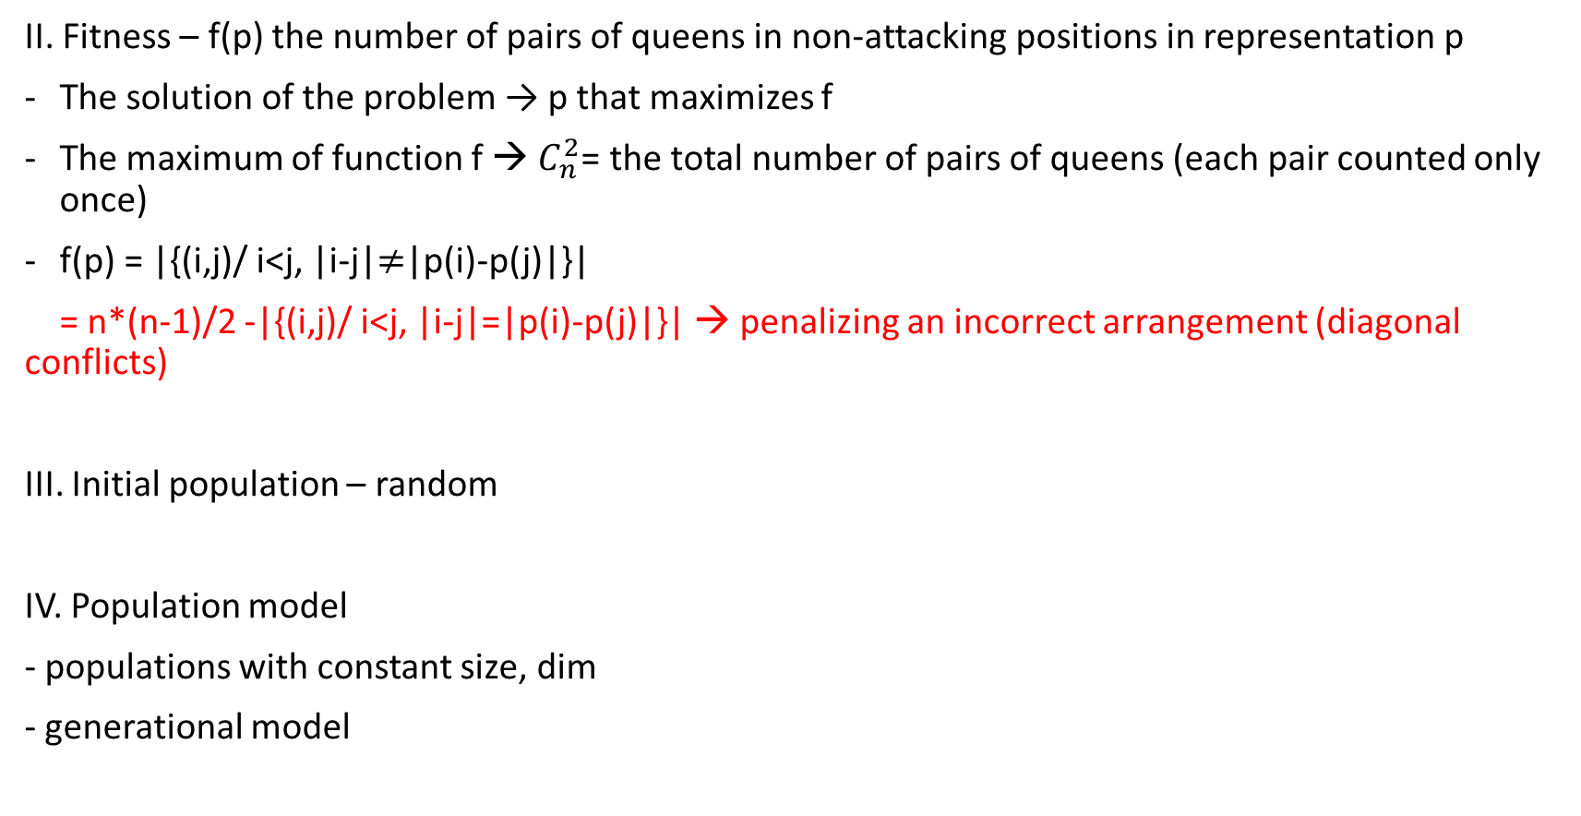
N-Queens problem
II. Fitness – f(p) the number of pairs of queens in non-attacking positions in representation p
The solution of the problem → p that maximizes f
The maximum of function f → $C_{n}^{2}$= the total number of pairs of queens (each pair counted only once)
f(p) = |{(i,j)/ i<j, |i-j|$≠$|p(i)-p(j)|}|
= n*(n-1)/2 -|{(i,j)/ i<j, |i-j|=|p(i)-p(j)|}| → penalizing an incorrect arrangement (diagonal conflicts)
III. Initial population – random
IV. Population model
- populations with constant size, dim
- generational model
The number of pairs of queens correctly positioned

Slide 3
N-Queens problem
V. Mutation
Mutation has a small probability to take place; pm = mutation probability
The problem uses individuals represented by permutations → the mutation process takes place at individual level
Pm = k/Dim → on average, the number of individuals for which mutation will take place is k
At population level – the general schema for mutation for problems modelled without constraints, representing individuals through permutations
At individual level
The problem becomes an ordering problem – mutation by insertion (it is also possible to use the swap mutation operator)

Slide 4
N-Queens problem
VI. Crossover
With high probability; pc = probability of crossover ( 0.6,0.7…)
Generational model → the generation of dim descendants must be ensured
dim parents → dim descendants : with probability pc the resulting (new descendants) individuals are new, and the rest come from the parents through asexual crossover
At population level – general crossover scheme for problems without constraints
The particular operator/method for crossover is chosen specifically for problems with order dependency – OCX (order crossover)

Slide 5
N-Queens problem
VII. Selection of parents
Number of parents – based on the used model (dim)
Fitness score is positive → any probability of selection can be used (FPS or rank) simulated with the SUS mechanism (recommended) or roulette
Possible choices – FPS with sigma scaling and SUS/roulette;
VIII. Replacement of the current population (Selection of Next Generation)
Replacement mechanism – based on the used model (generational)
All offspring (descendants) are propagated, except when the best ”old” individual (from the current generation) is better than all new individuals → elitism

Slide 6
N-Queens problem
IX. Conditions for continuing the search for best solution
The number NMAX evolutive cycles (generations) has not yet been exceeded.
There are at least 2 individuals in the population that have different fitness score (otherwise the genetic variability is null)
The already-known maximum fitness score has not already been found

Slide 7
N-Queens problem
Black Box
Problemă
Cutie neagră
Problem
Stabilire reprezentare și funcție obiectiv
Generare populație inițială
Generație curentă
Multiset părinți
Descendenți (încrucișare)
Descendenți (mutație)
Generație nouă
Rezultat
Populație finală
Soluție
Decodificare
Solution

Slide 8
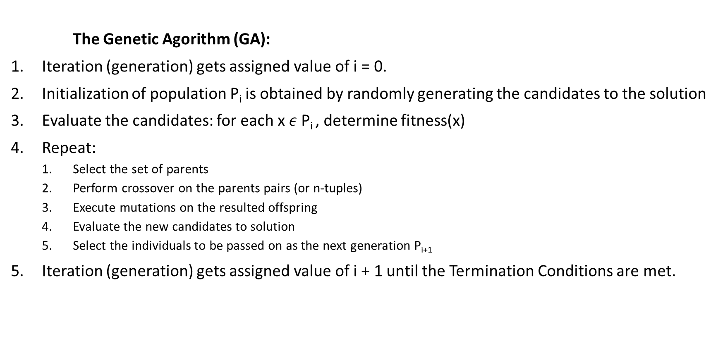
N-Queens problem
The Genetic Agorithm (GA):
Iteration (generation) gets assigned value of i = 0.
Initialization of population P_{i} is obtained by randomly generating the candidates to the solution
Evaluate the candidates: for each x $ε$P_{i} , determine fitness(x)
Repeat:
Select the set of parents
Perform crossover on the parents pairs (or n-tuples)
Execute mutations on the resulted offspring
Evaluate the new candidates to solution
Select the individuals to be passed on as the next generation P_{i+1}
Iteration (generation) gets assigned value of i + 1 until the Termination Conditions are met.

